Slide 1
“BUSINESS KNOWLEDGE FORMATION
USING DATA SCIENCE TOOLS ”
SUBMITTED BY
PALLAVI KC

Slide 2
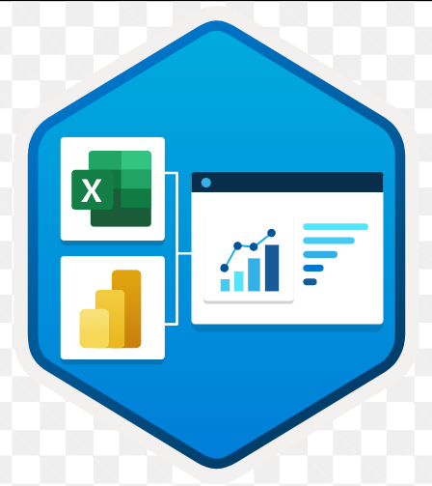
LIST OF CONTENCTS
Introduction on Business Data Analysis
Data Analysis Tools Used
Why Data Analysis ?
Overview of Power BI Desktop
Data Analysis Process
Implementation
Creating a Dashboard
Conclusion
Reference

Slide 3
DATA ANALYSIS
“To grow your business even to grow in your life, sometimes all you need to do is Analysis!”
Unstructured data to an structured data.
Typically work with structured data to solve Tangible Business Problems.
Decision-making.
To make sense of the past and to predict future trends and behaviours.
Analyzing raw data in order to draw out meaningful data, actionable insights,
To inform and drive smart business decisions.
To be analyzed in an iterative.
To solve specific problems and challenges within an organization.

Slide 4


DATA ANALYTICS TOOLS USED
Microsoft Excel: Is a software program that enables you to organize, format, and calculate data using formulas within a spreadsheet system. Microsoft Excel may be used by data analysts to run basic queries and to create pivot tables, graphs, and charts. Excel also features a macro programming language called Visual Basic for Applications (VBA).
Power BI: Is a business analytics solution that lets you visualize your data and share insights across your organization. Similar to Tableau, Power BI is primarily used for data visualization. While Tableau is built for data analysts, Power BI is a more general business intelligence tool.

Slide 5
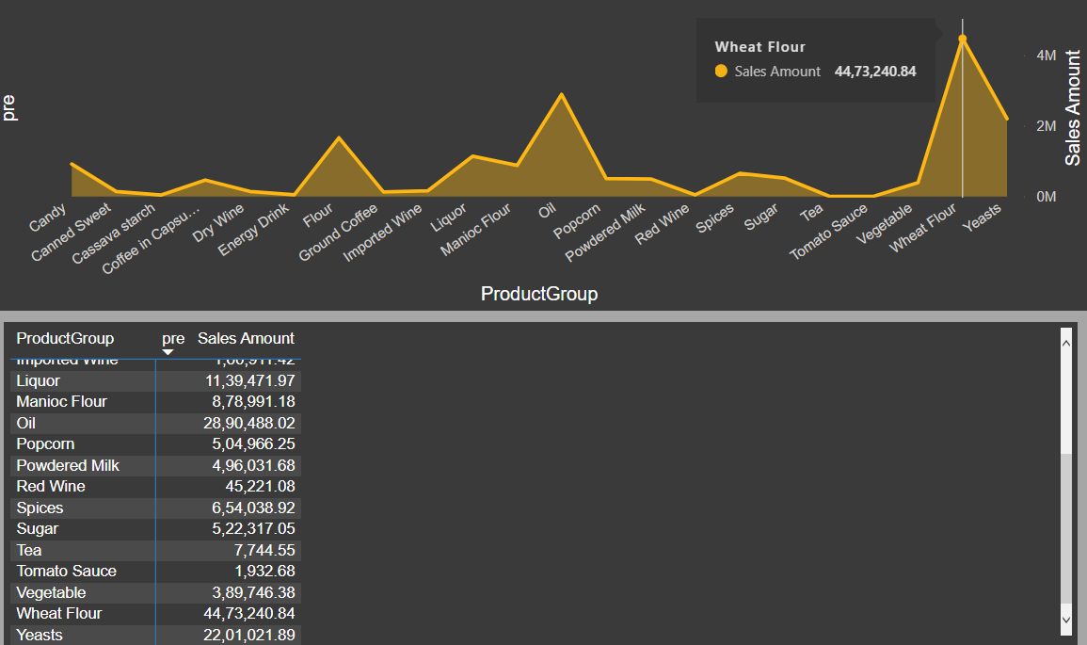
WHY DATA ANALYSIS?
If raw data form, this data doesn’t really mean anything.
To make sense of the past and to predict future trends and behaviours.
To inform and drive smart business decisions.
It gives the clear picture then the numbers is an smart work.
For Example:
Graph with analysis
Table with
numbers

Slide 6
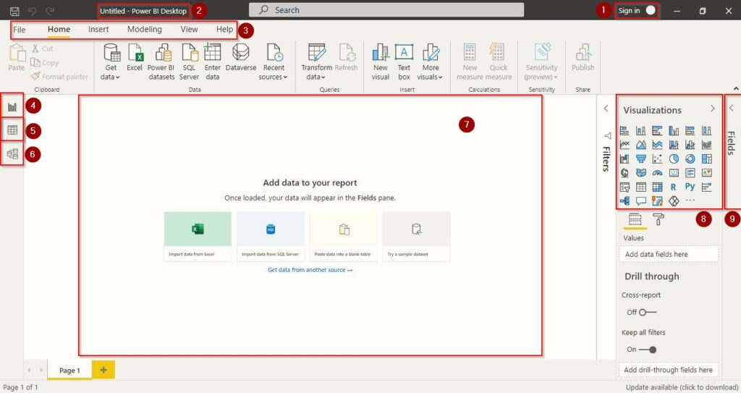
Overview of power BI desktop
KNOW YOUR WORKSPACE :-
10
Overview of Power BI Desktop

Slide 7
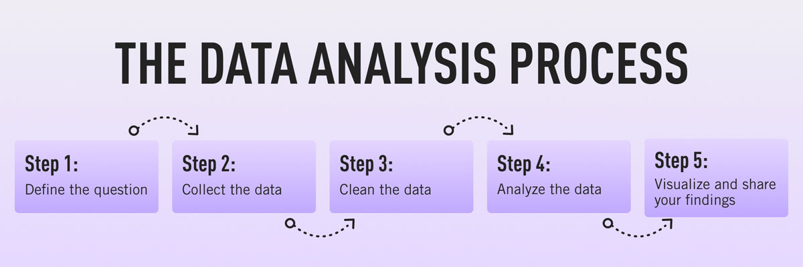
The data analysis process
ABSTRACT:
Data analysis is a process of inspecting, cleansing, transforming, and modelling data with the goal of discovering useful information, informing conclusions, and supporting decision-making.
FIVE STEPS IN DATA ANALYSIS PROCESS:
Flow of Data Analysis Process

Slide 8
STEP 1: DEFINE THE QUESTION
-: IMPLEMENTATION :-
Sales Data Analysis :- Given a details of sales data set we have to create an dashboard analyze on year wise profit and loss in terms of visualization.
Sales analysis involves analyzing sales data of a business over time.
A well-executed analysis can help you understand areas to improve.
Every company has a sales target set at the start of a financial year.
The sales and marketing department is always the rainmaker of any business.
Typically work with structured data to solve Tangible Business Problems.

Slide 9
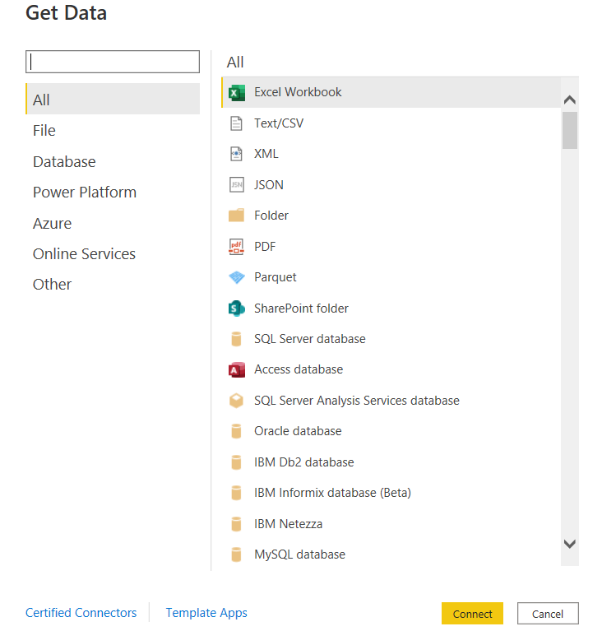
STEP 2: COLLECT THE DATA
Get data.
Power BI Services.
Available data sources.
Provide the location of the file.
Transform data.
Power BI Services

Slide 10
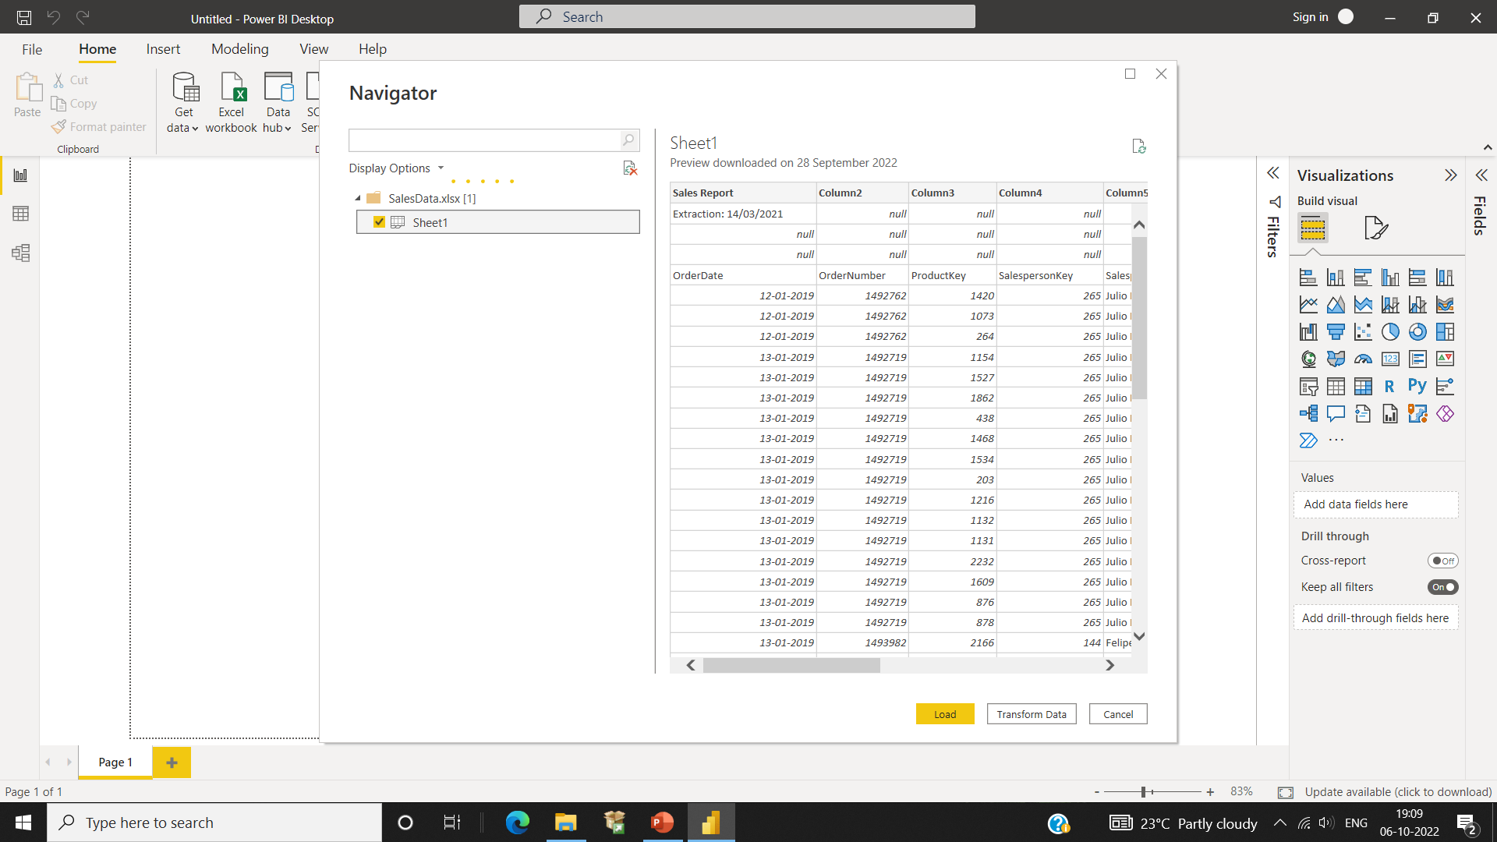
COLLECTING THE DATA FROM FILE LOCATION TO POWER BI DESKTOP
Connecting...
Dataset…
Collecting The Data

Slide 11
STEP 3: CLEAN THE DATA
Data Transformation Through Power Query.
Data Structuring for Column Headers & Names.
Removing Irrelevant & Duplicate Rows.
Renaming the Columns.
Unpivoting the Columns.
Use Power Query to clean and transform data for a data model.

Slide 12
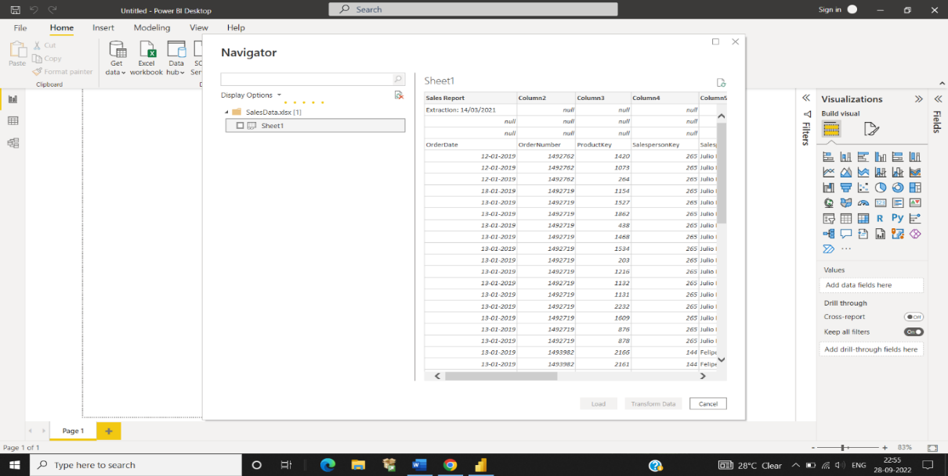
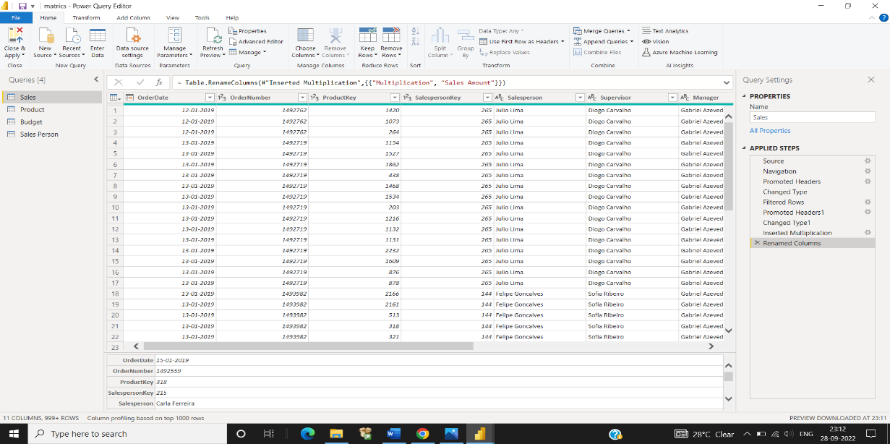
Data Transformation Through Power Query.
Removing all null values and cleaning the data set in a ‘Unstructured Data to Structure Data’ ( meaningful data set ).
Data Structuring for Column Headers & Names.
Power Query Editor…
Unstructured Data to Structure Data…

Slide 13

STEP 4: Analyze THE DATA AND MODEL
Viewing and Exploring
Content and Explain
Reports and Dashboard
Share New Business Insights
Diagramming Data Flow
Relationship
Analyse The Data

Slide 14
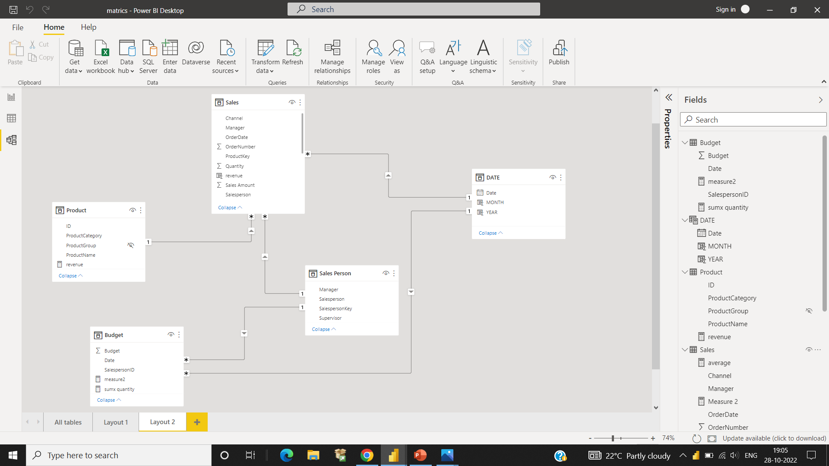
DATA MODELING…
Model…
Data Modeling is one of the features used to connect multiple data sources in BI tool using a relationship. A relationship defines how data sources are connected with each other and you can create interesting data visualizations on multiple data sources.

Slide 15
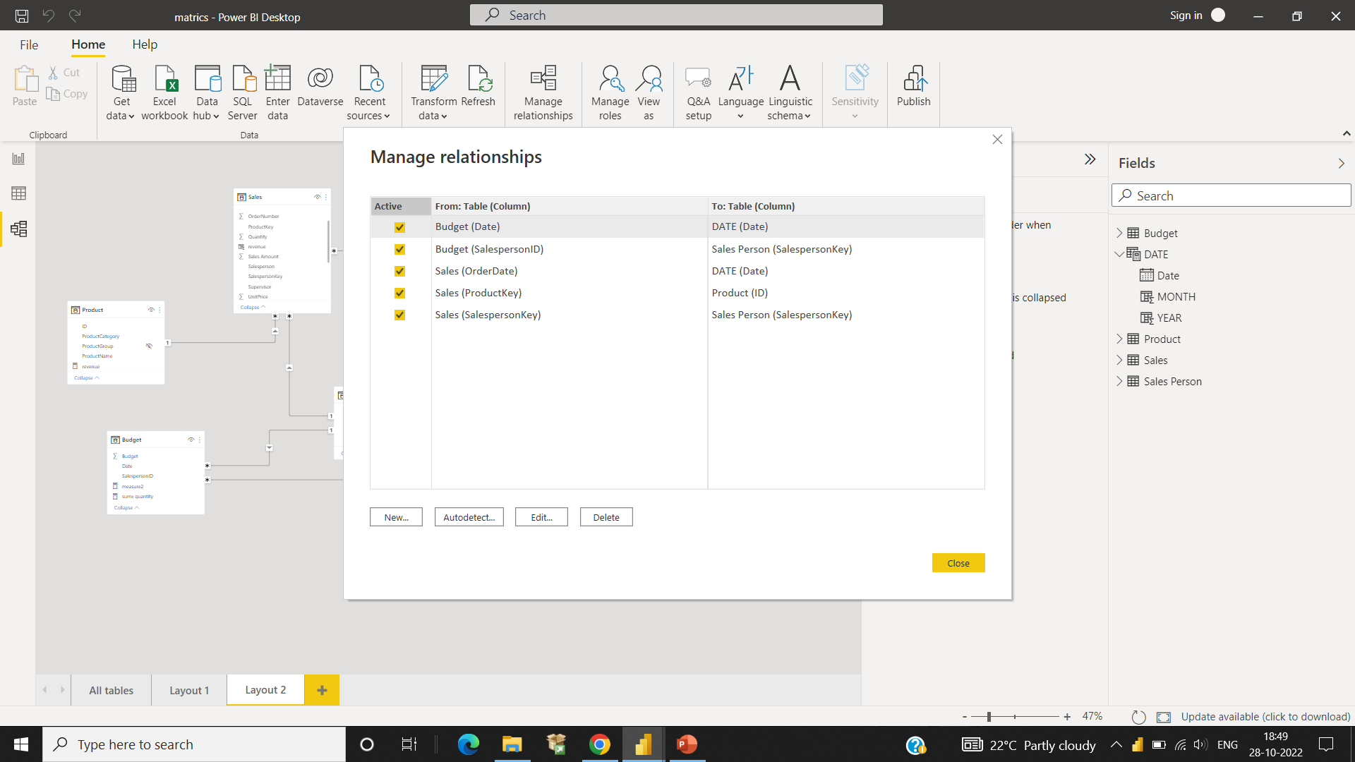
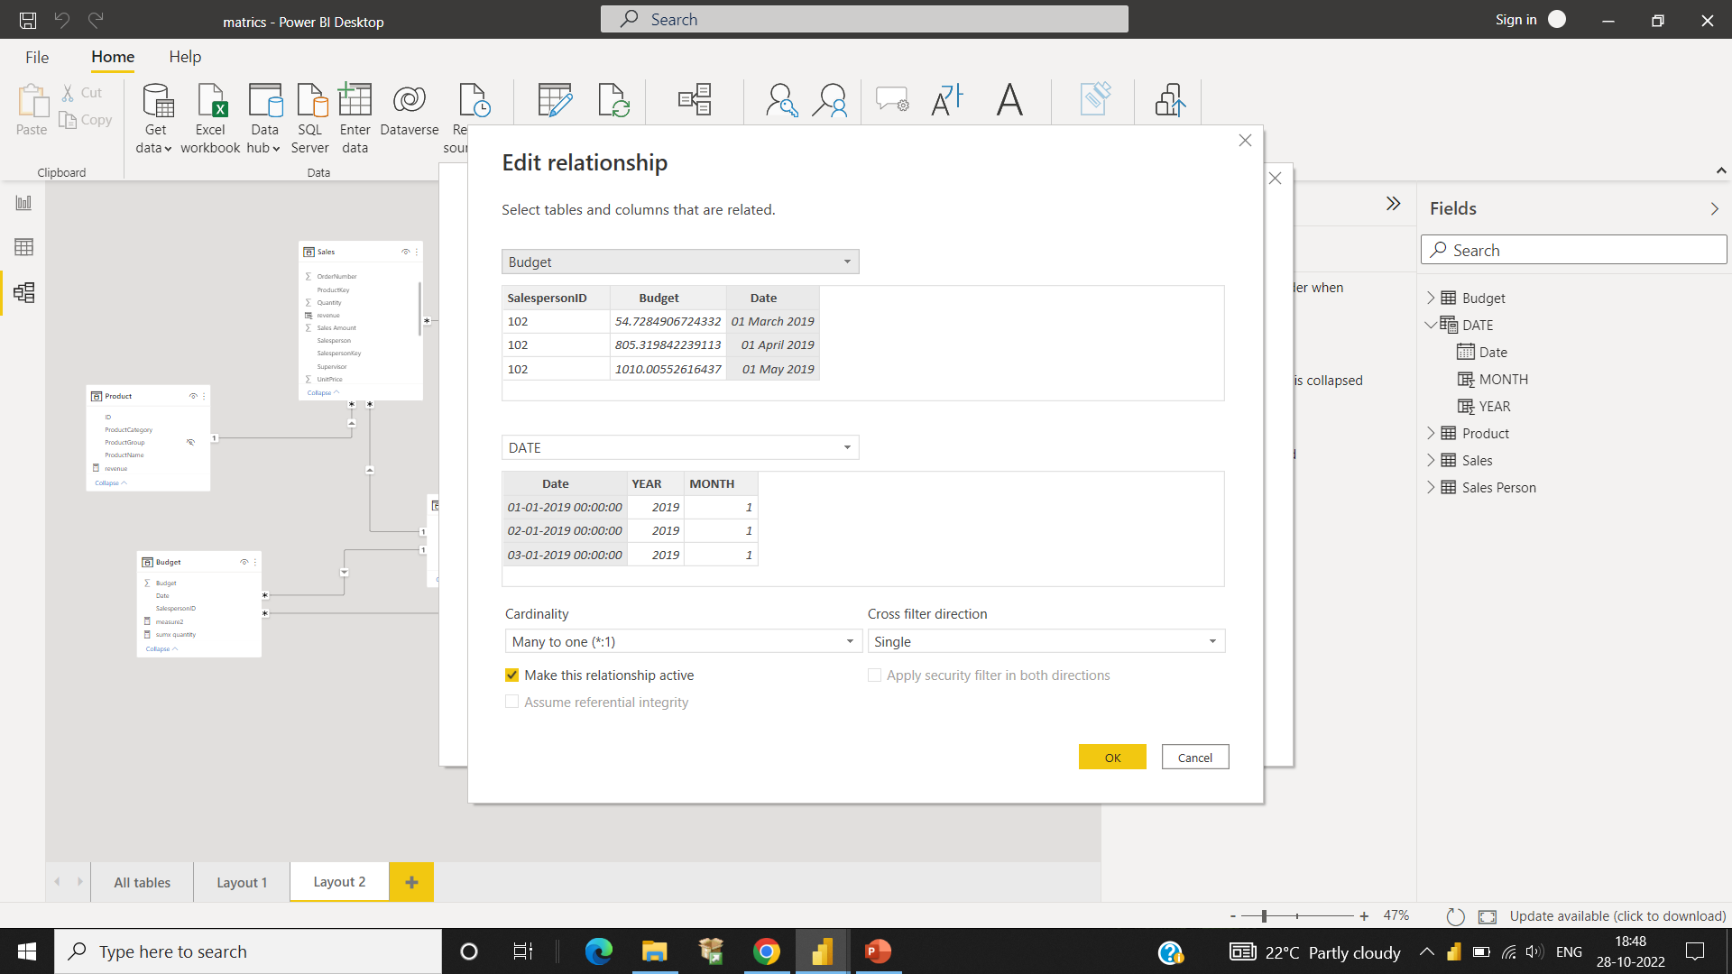
After clicking on ‘Manage Relationship,‘ a similar screen will appear, as shown in the above image. You can see all the active relations here from one table to another.
Relationship from One Table to Another
Edit relationship

Slide 16
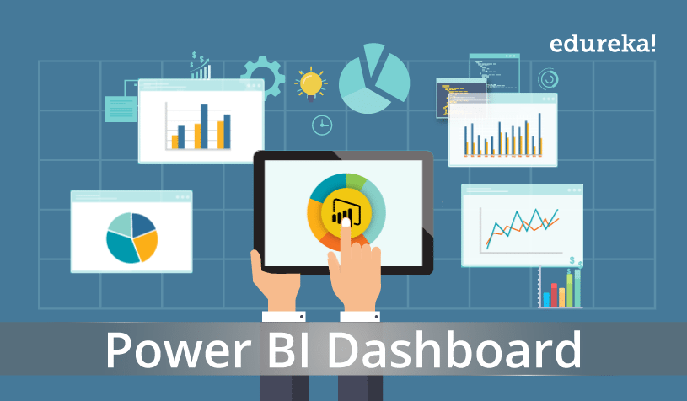
STEP 5: VISUALIZE THE DATA
To Explore.
To Monitor.
To Explain.
Represent information graphically.
Master storyteller.
Highlighting patterns.
Trends in data.
Insights hidden within your numbers.
Business insight quickly and effectively.
Visualize The Data

Slide 17
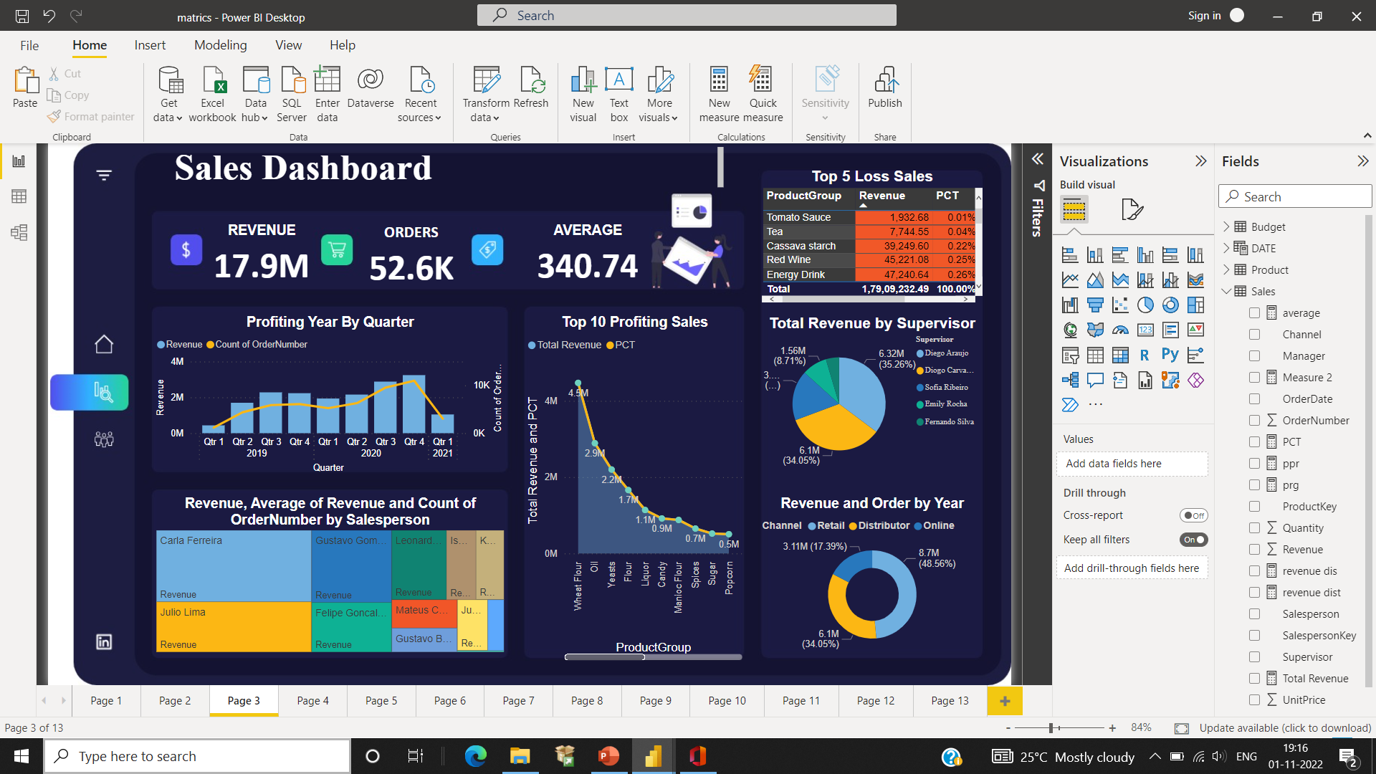
-: CREATING A DASHBOARD :-
:- Overall Profits of The Sales
NOTE: Type of Chart Used
CARD: A card is useful to display a single number (or metric value).
:- Total Order Numbers of The Sales.
:- Average Taken From The Sales Using DAX Function.
FORMUAL:-
Average = SUM(‘Sales’[Sales Amount]) / DISTINCTCOUNT((‘Sales’[OrderNumber]))

Slide 18
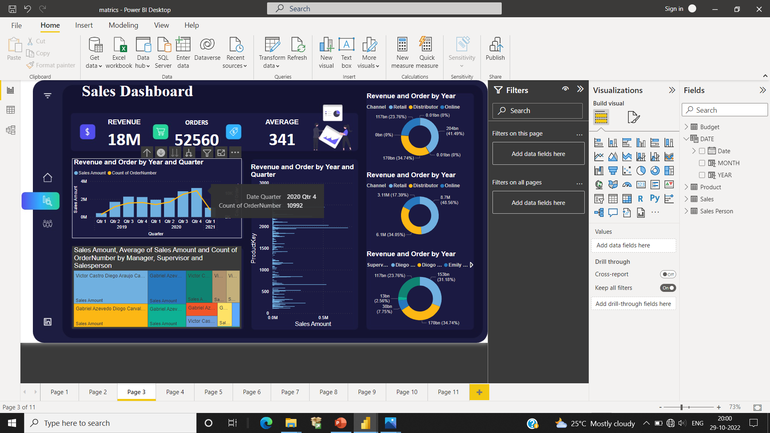
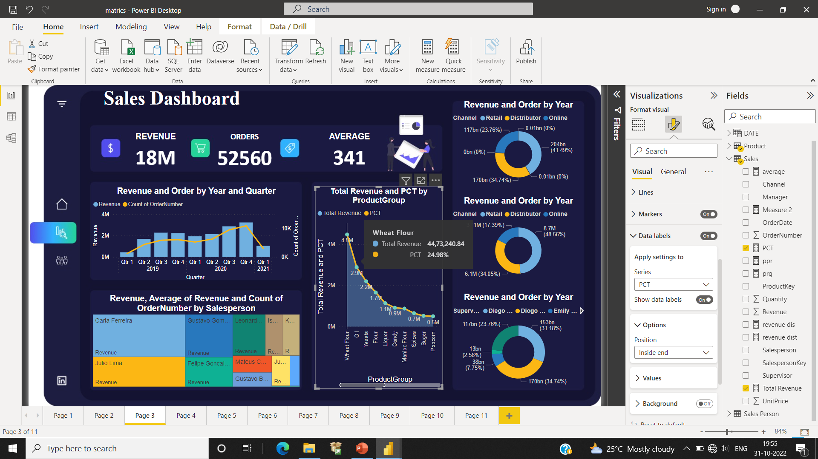
Line and Clustered Column Chart
:- It shows quarter sales analysis with the help of fields and it gives clear picture of sales data.
Stacked Area Chart
:- It shows analysis total revenue with percentage by product group sale with the help of fields and it gives clear picture of sales data.
FORMULA:
Total Revenue = SUM(‘Sales’[Revenue])
PCT = (Sales[Total Revenue] / Sales[PRG])

Slide 19
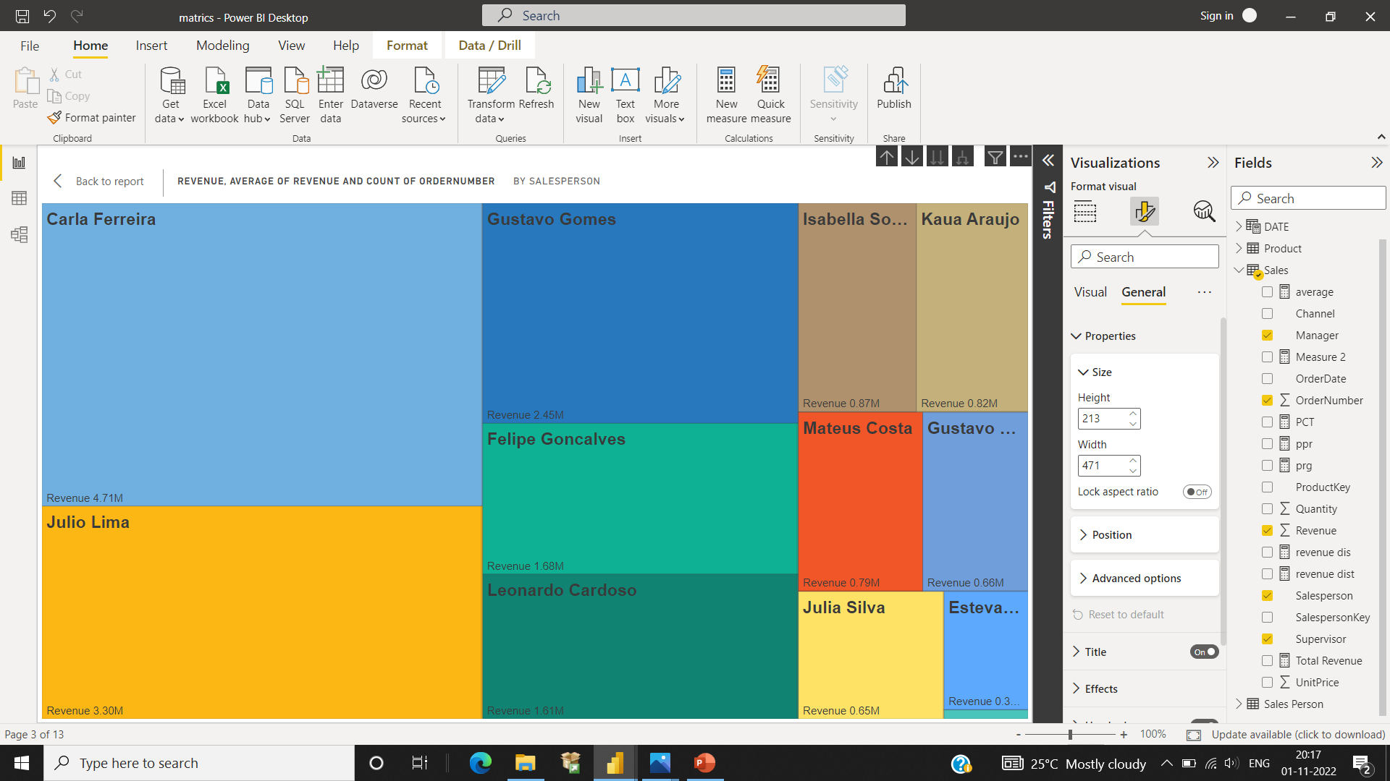
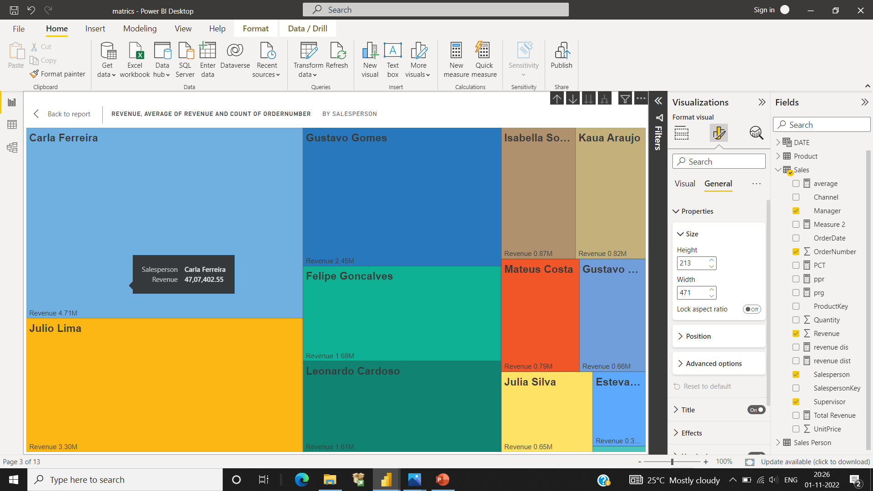
Quantity by Salesperson
Treemap
:- It shows the quantity of order number done by the sales persons.
FORMULA:
Average = SUM ('Sales'[Revenue]) /
DISTINCTCOUNT (('Sales'[OrderNumber]))
Table
:- It shows the loss of the sales using conditional formatting is highlighted, loss product with the red color.
FORMULA:
PCT = (Sales[Total Revenue] / Sales[PRG])
PRG =CALCULATE(SUM(‘Sales’[Revenue]),All('Product'))
Total 141,388.55 0.78%

Slide 20
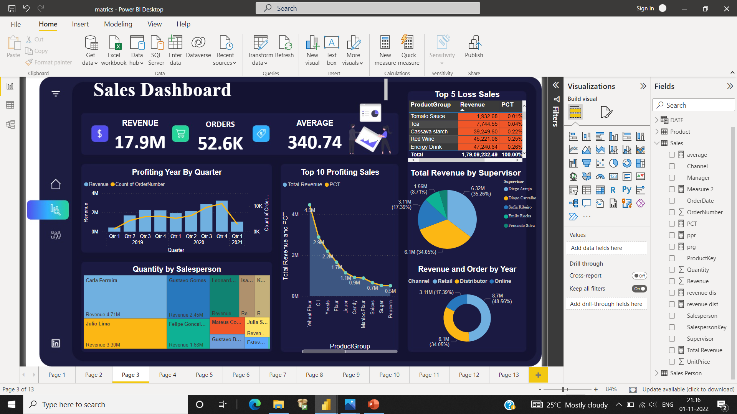
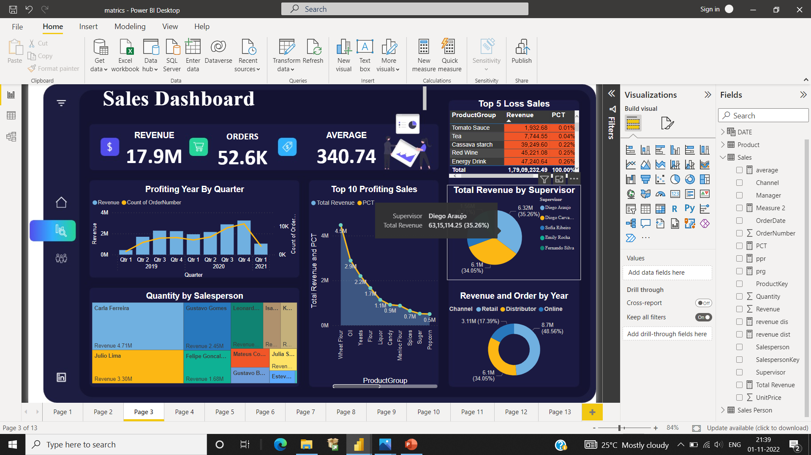
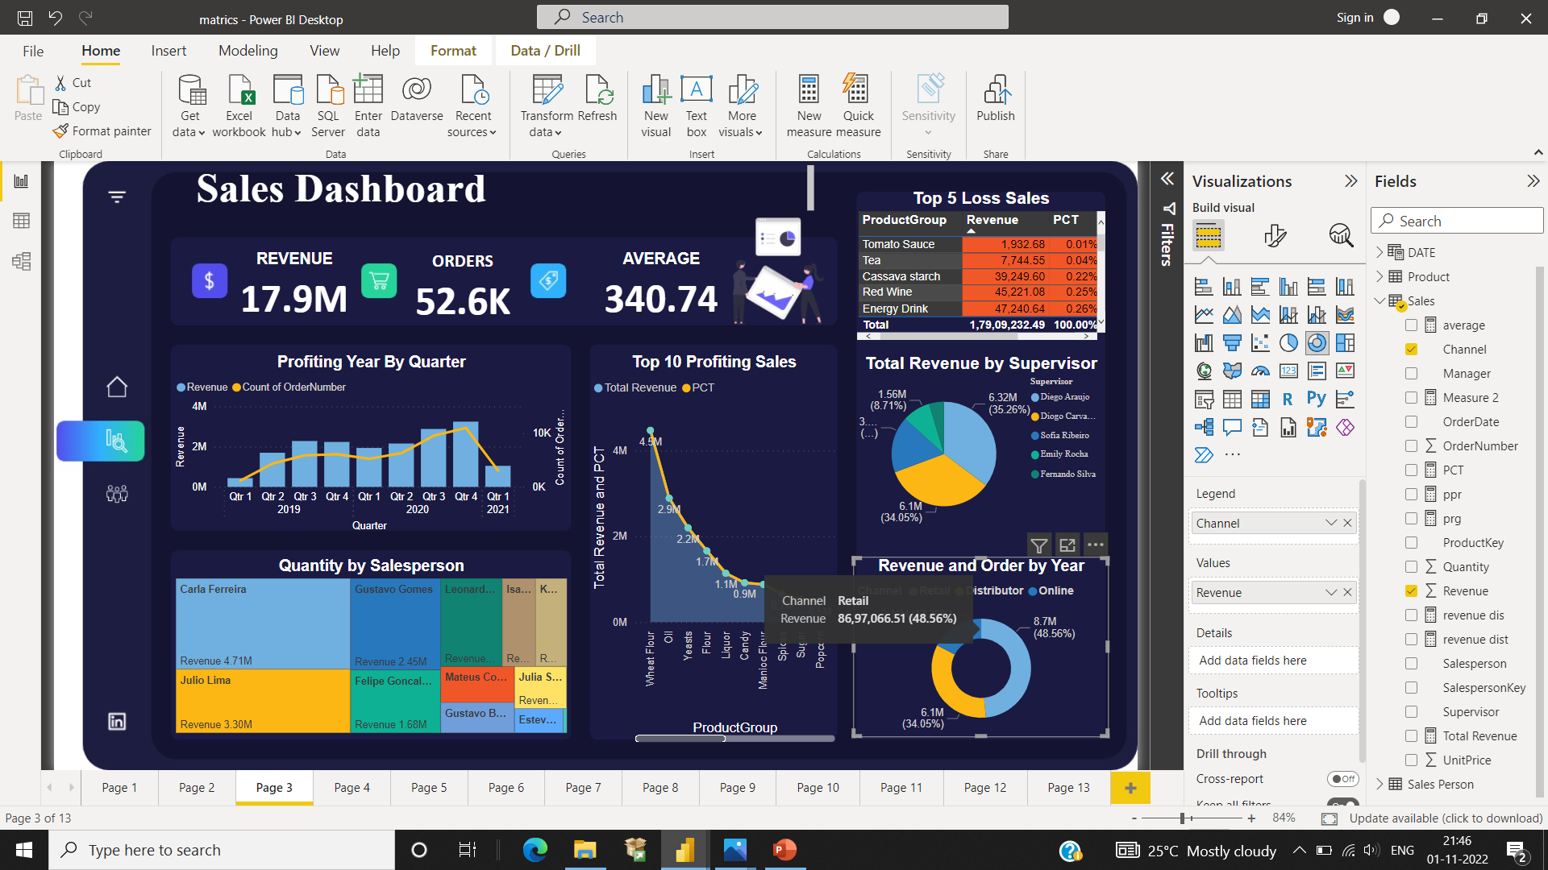
Pie Chart
:- It shows total revenue done by the supervisor of the sales.
Donut Chart
:- It shows total revenue as been done by the channel of the sales.
A Power BI dashboard is a single page, often called a canvas, that tells a story through visualizations. Because it's limited to one page, a well-designed dashboard contains only the highlights of that story. Readers can view related reports for the details. Dashboards are a feature of the Power BI service only.

Slide 21
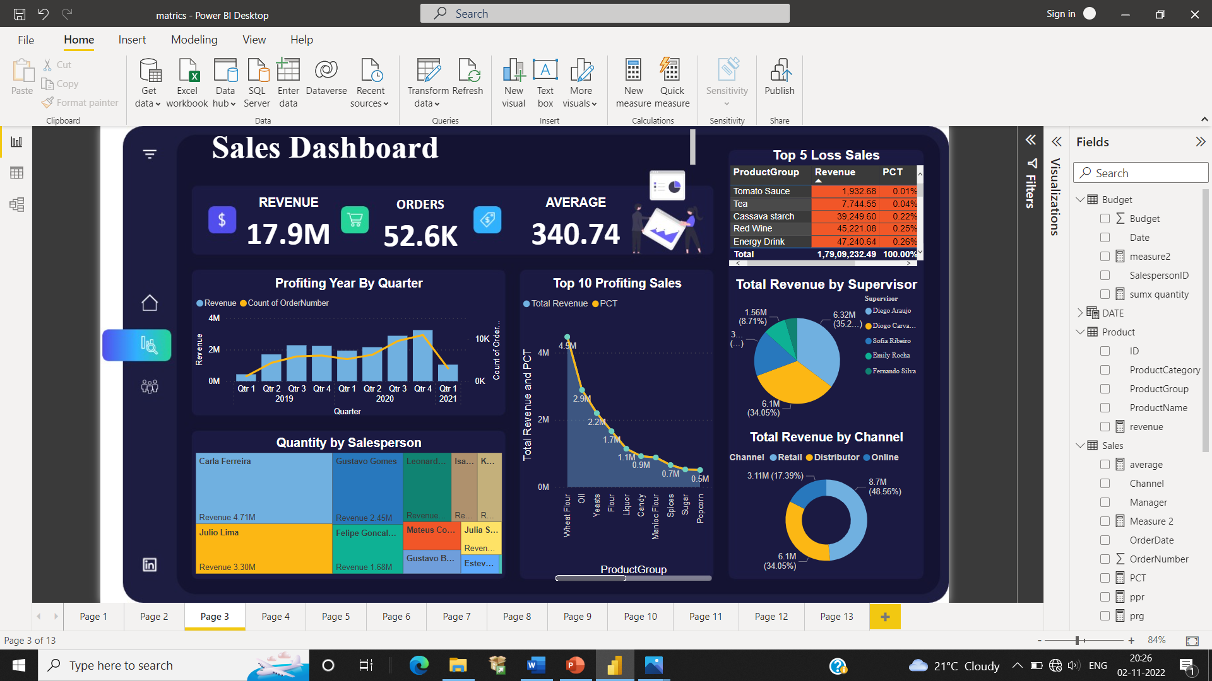
VISUALIZATION OF SALES DATA IN DETAIL AND CREATED A DASHBOARD…
Total 141,388.55 0.78%

Slide 22
-:CONCLUSION:-
As more and more data is generated and collected, data analysis requires scalable, flexible, and high performing tools to provide insights in a timely fashion. However, organizations are facing a growing big data ecosystem where new tools emerge and become outdated very quickly.
Derive a conclusion regarding the information they hold.
Clearly communicate what a dataset can and cannot tell us about the world.
Find trends and solve problems.
Shaping business processes and improving decision-making and business results.

Slide 23
-:REFERENCE:-
WEBSITES:
https://support.microsoft.com/en-us/office/excel
https://www.microsoft.com/en-ww/microsoft-365/excel
https://www.javatpoint.com/excel-tutorial
https://www.tutorialspoint.com/power_bi/
https://www.khanacademy.org/math/statistics-probability
BOOKS:
POWER BI AND EXCEL:
Power Pivot and Power BI. The Excel User’s Guide to DAX, Power Query, Power BI Power Pivot in Excel 2010-2016 (Rob Collie, Avichal Singh) (z-lib.org)

Slide 24
THANKING YOU….

